Slide 1

Experiment Plasma Jet in $μ$tubes
Author : THAWPICK Laurent
Tutor : DOUAT Claire

Slide 2
Method to determine plasma size and compare to manual method

Slide 3
Problem : On the left for all high peak curve part, we can’t the maximum because the max value for each curves are saturated and is due to the optical reflexion of the sensor. So, in this case we need to find 1 or 2 methods to find the plasma size with accuracy.

Slide 4
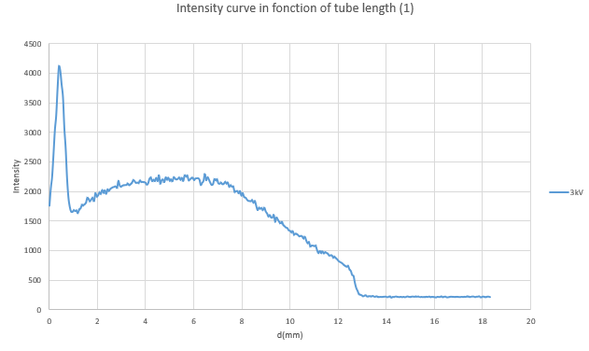
Method 1 : Average of middle state of plasma (heart of the plasma )
Example with 3kV

Slide 5

Average of middle
A0
B0
On excel : Average (A0::B0) → $I_{average}$

Slide 6

Calculation of height of the plasma above the bottom
$$I_{average}−C0=Ic$$
C0

Slide 7
We then consider the plasma to have ended on the right when it has lost 90% of its intensity in the medium (that is, when only 10% of its height above the bottom remains).
$$I_{end of plasma }= IC+(0.1∗I_{average})$$
When we got the intensity value, we take the length value associated to have the length of plasma in mm. (+- 0.6 mm between 2 value because we don’t have a value directly associated at the table).
With this method, we suppose that this value It’s the beginning of extinction of the plasma.

Slide 8
Method 2 : Average of last state of plasma (extinction of the plasma )
Example with 3kV

Slide 9

Average of the right part
On excel : Average (A0::B0) → $I_{average}$
A0
B0

Slide 10
The plasma begins exactly where the curve deviates from this flat line (using a margin of +10% above the flat line to avoid picking up small noise fluctuations.
So, we need to take +10% of the average value that we calculated to be just above the flat line → end of plasma length
$$I_{end of plasma }=(I_{average}∗0.1)+I_{average}$$
With this method, we suppose that this value It’s the end of extinction of the plasma.

Slide 11

Summary for the first try

Slide 12


$$\left\langle I_{1}\right\rangle =\left\langle I_{c }\right\rangle +(0.1∗\left\langle I_{M}\right\rangle )$$
$$\left\langle I_{c }\right\rangle =\left\langle I_{M}\right\rangle −C_{0}$$
$$\left\langle I\right\rangle =\left(\left\langle I_{1 }\right\rangle ∗0.1\right)+I_{0}$$

